Slide 1


Crowd-sourcing data: Practical lessons and potential applications
Dwight Kravitz
Department of Psychology

Slide 2
Outline
Improving scientific practice
Modelling post-hoc research practices
Mechanical Turk pipeline for behavior
Estimating a priori power
Decomposing RT to increase power
Deeply scary things to consider
The ever increasing skill set
Mo’ data, Mo’ problems

Slide 3

Airport Scanner Smartphone App
As of 5/20/2017
>12.3 million installs
~3.1 billion trials
As of 5/18/2018
>14.4 million installs
~3.6 billion trials

Slide 4

Necessary Components

Slide 5
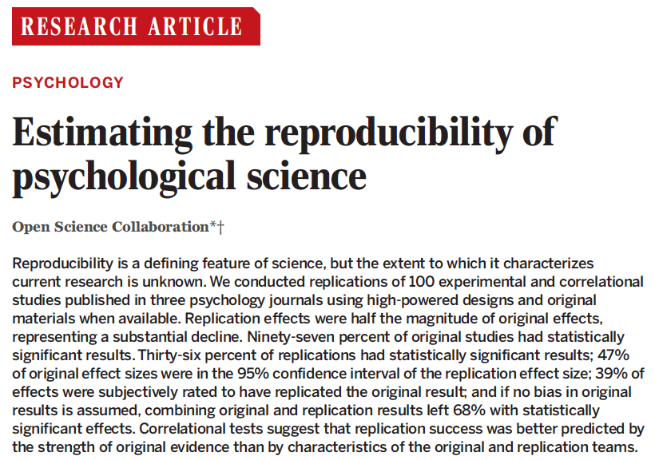
The replication crisis

Slide 6

Simple View of the Scientific Method
Literature Review & Hypothesis Formation
Methods & Data Collection
Results
Significant Results:
Publication!!
Null Results:
Filedrawer??

Slide 7
The Filedrawer Problem: False Discovery Rate Inflation
Creates an ambiguity as to whether a published result indicates a replicable difference between conditions.

Slide 8
Other Bad Ideas
Literature Review & Hypothesis Formation
Methods & Data Collection
Adding data after looking at results
Retaining pilot data in final analyses
Results
Significant Results:
Publication!!
Null Results:
Filedrawer??

Slide 9
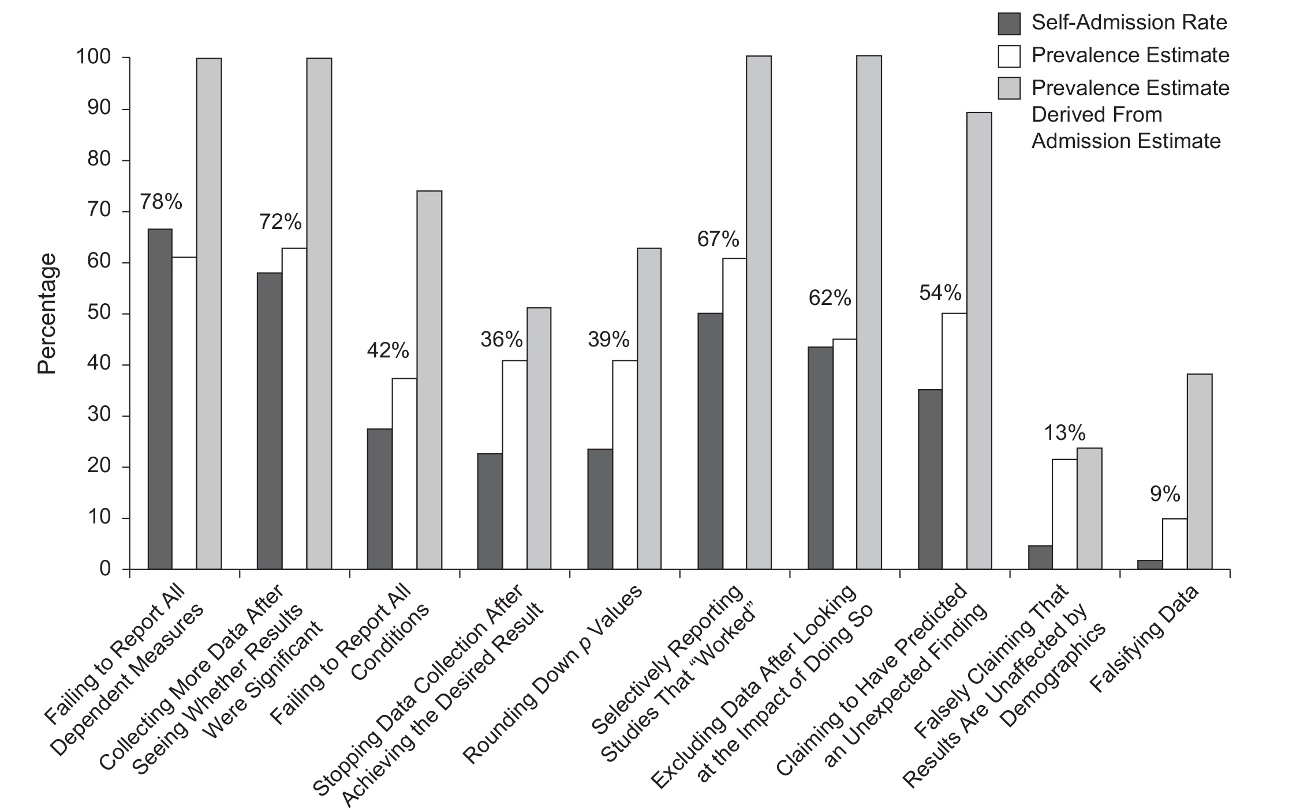
Yes, these things actually happen
John, Loewenstein, Prelec, 2012

Slide 10
Participants
Set Size 9
Trials
Set Size 13

Slide 11
Airport Scanner Smartphone App
N = 56,081
Accuracy (Hit Rate)

Slide 12
Participants
Set Size 9
Trials
Set Size 13

Slide 13
Participants
Set Size 9
To set true effect to null, flip half the trials between conditions
Trials
Set Size 13

Slide 14
Participants
Set Size 9
Trials
Set Size 13
Notes:
Retains all the natural variation. In full dataset can run without replacement

Slide 15
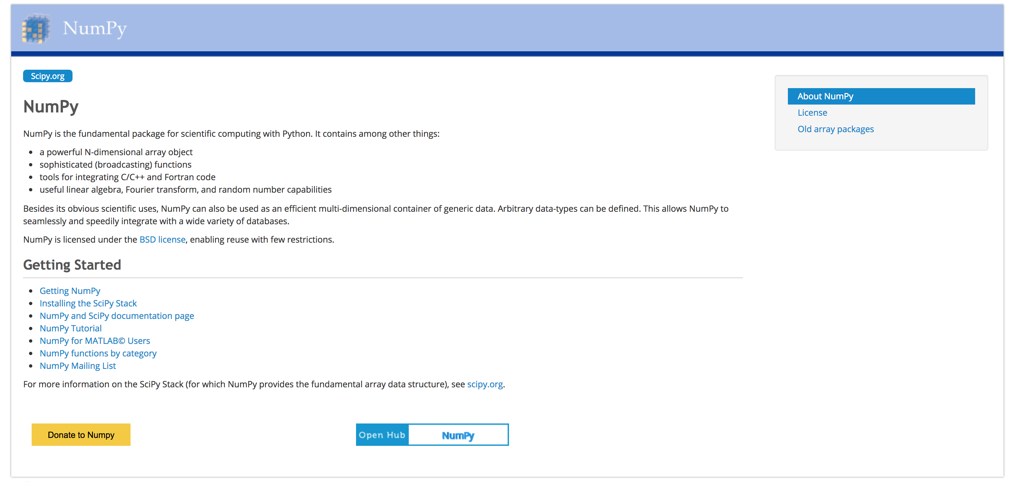
Analysis software
Python is free and numpy is Matlab with different brackets
Always Google problems! Github and StackOverflow users have usually already complained and fixed it.

Slide 16
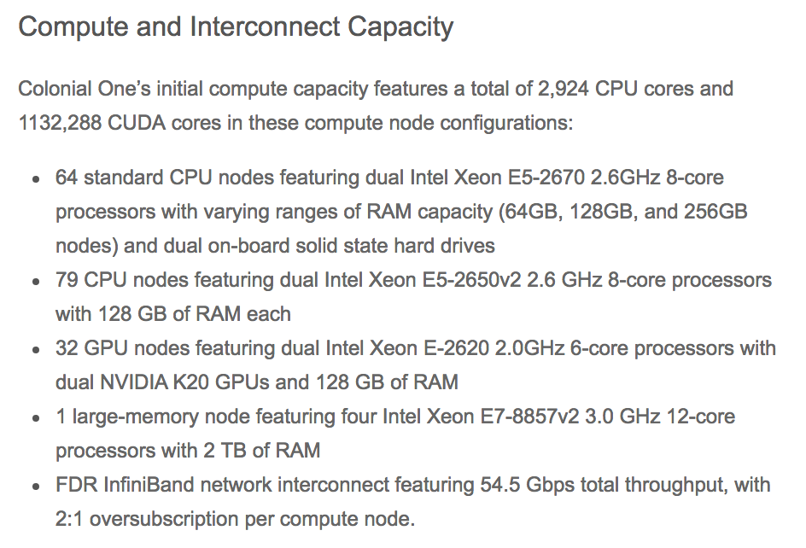

Analysis architecture
Colonial One
Supercomputer
GPU Parallelization

Slide 17
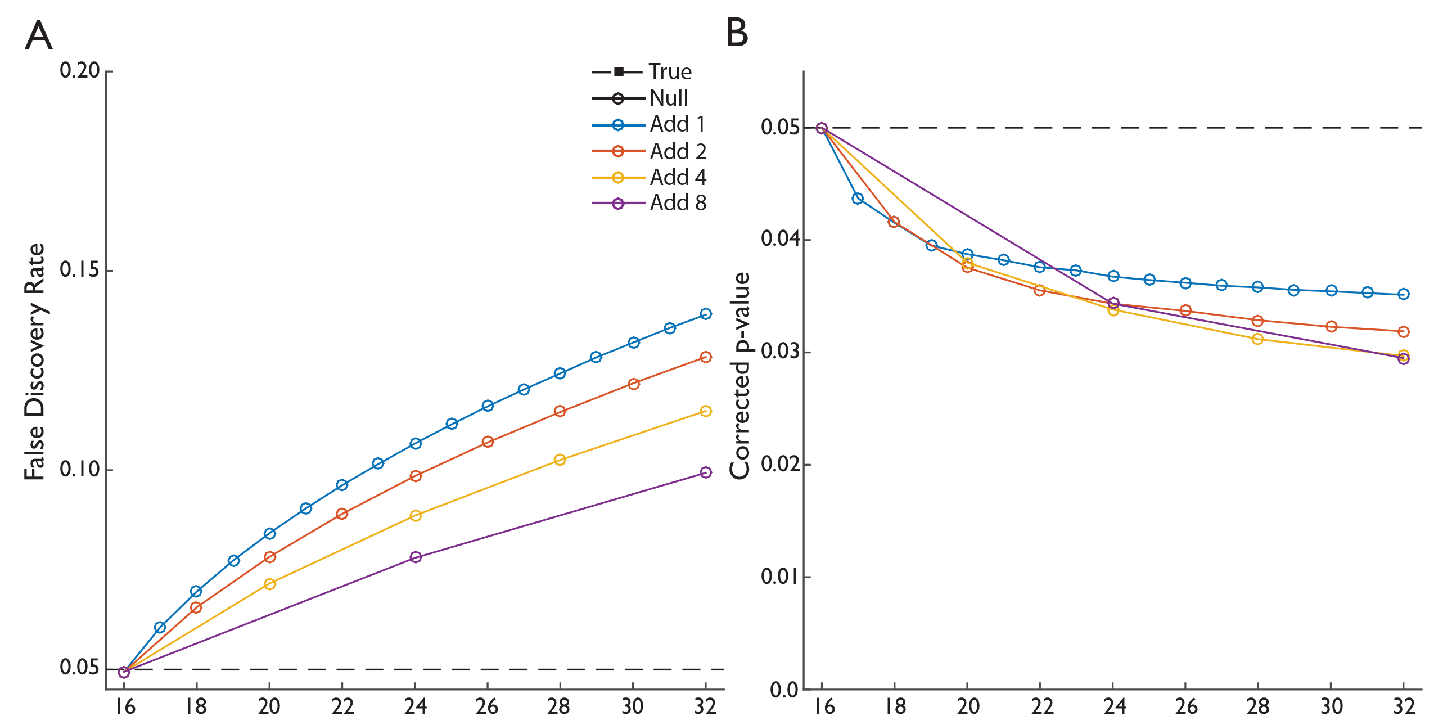

Adding participants inflates FDR

Slide 18
Adding participants inflates FDR

Slide 19
Adding participants inflates FDR

Slide 20
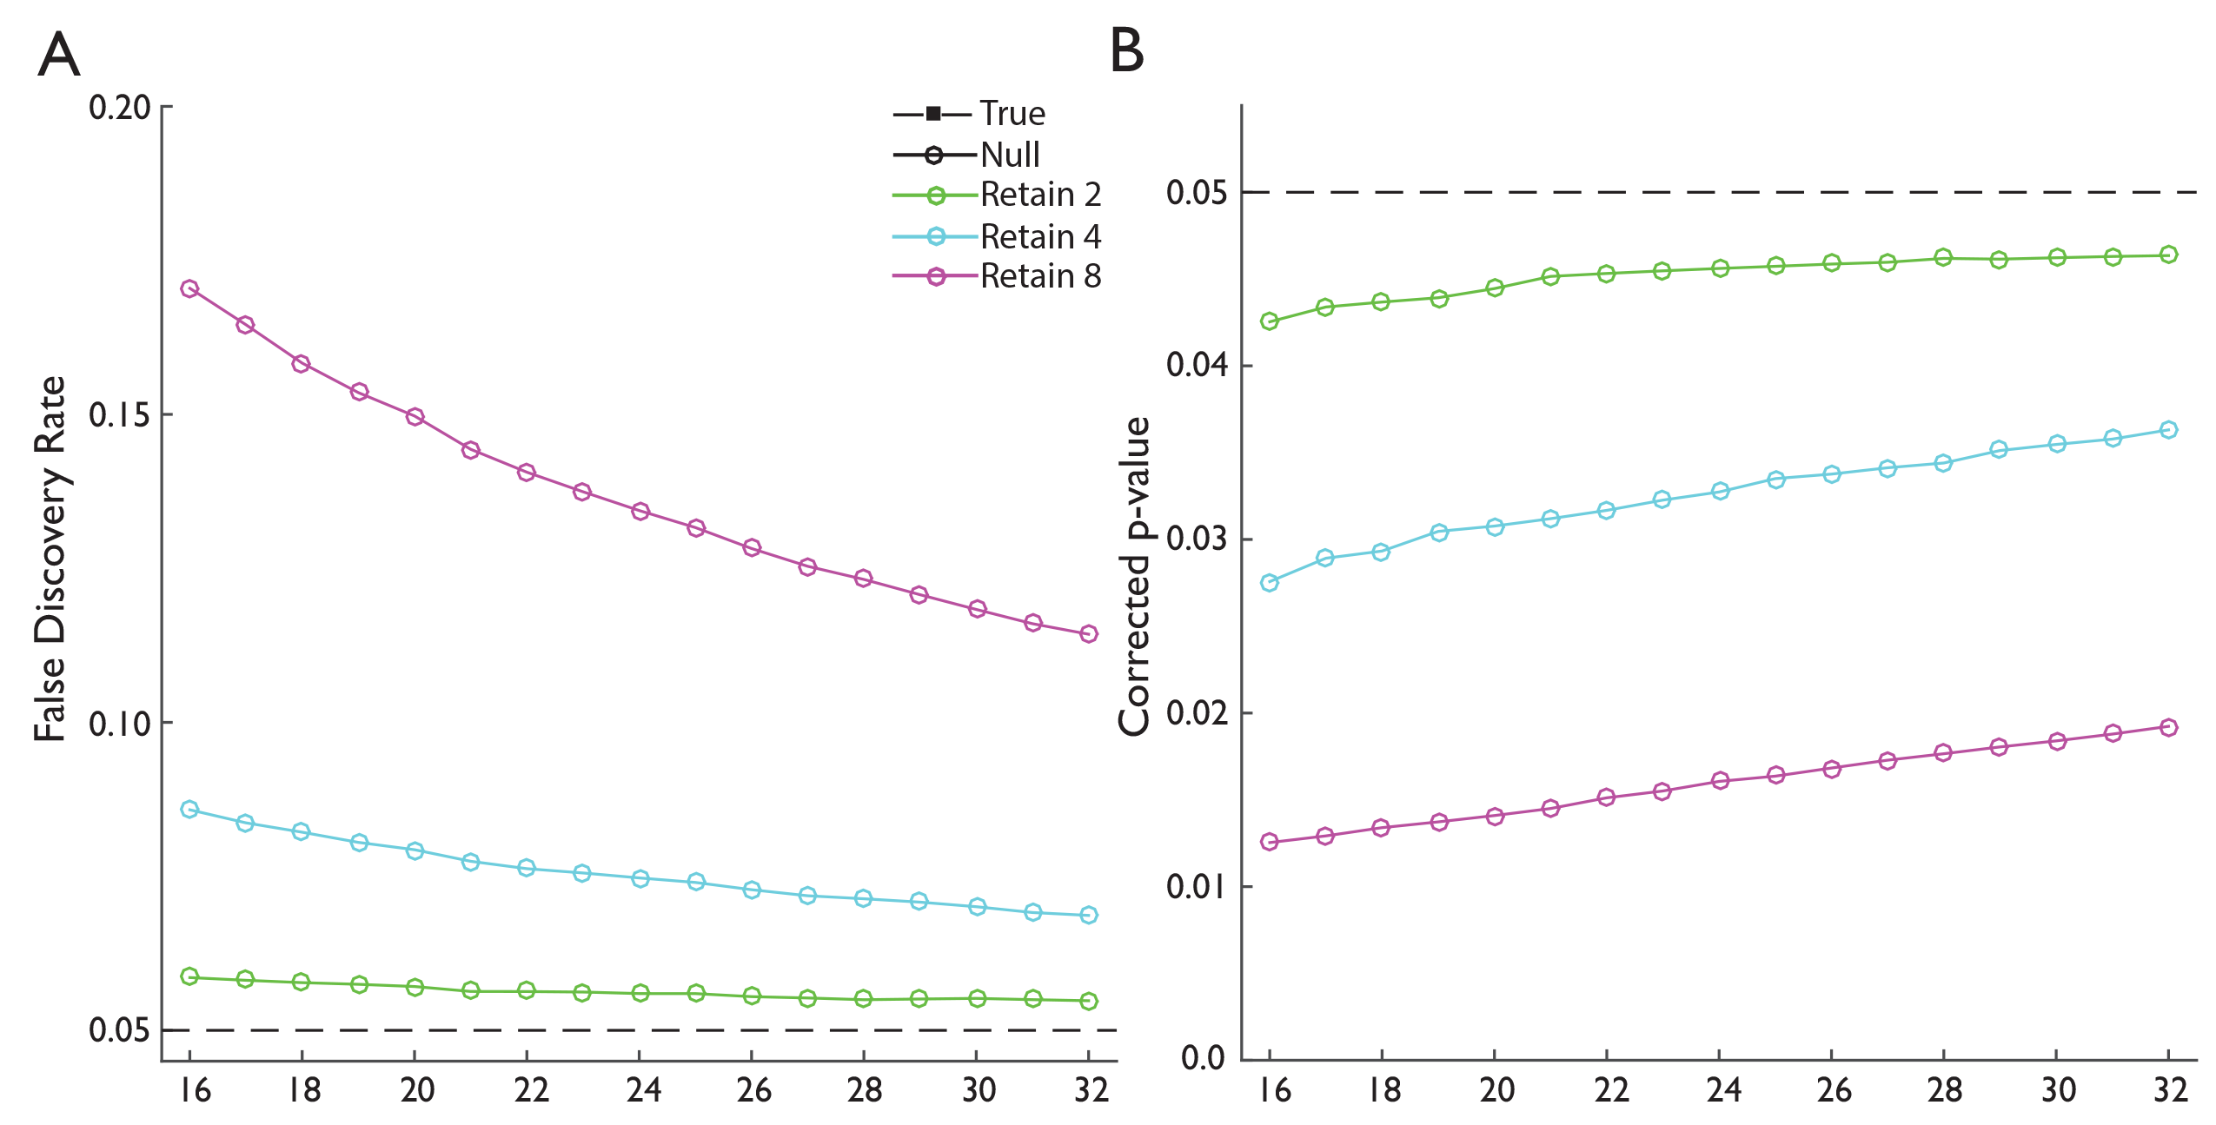
Retaining pilots inflates FDR

Slide 21
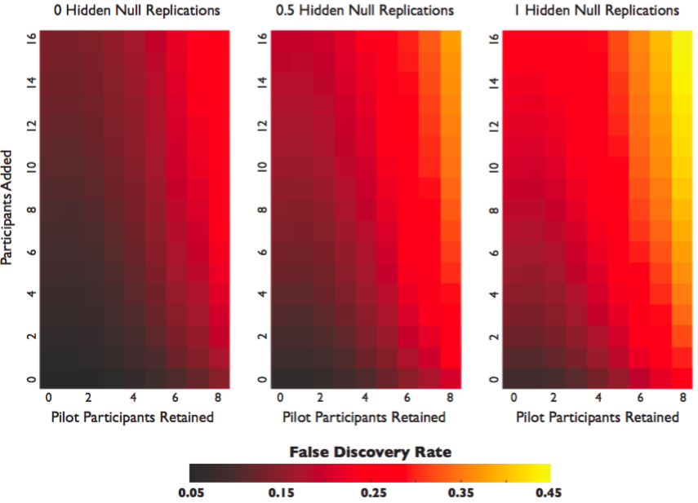
The three practices combined …

Slide 22
Reversing an effect
Accuracy (Hit Rate)
Error bars = 95% CIs

Slide 23
Avoidance, Correction and Transparency (ACT)
Avoid these practices when possible.
Correct when necessary.
Transparently report what you did!

Slide 24
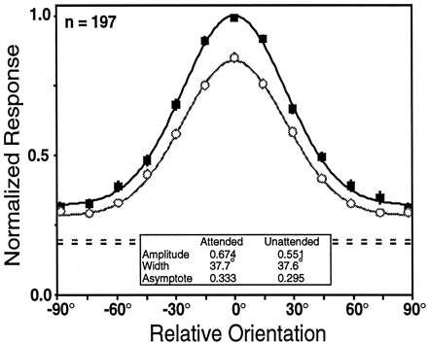
New pipeline applied and bad practices avoided!
1 Week: JavaScript Implementation
4 Hours: Testing and Logging (5-10 Participants)
2 Days: Data Collection (50 Participants, <500$ total cost)
Tuesday Morning Talk 9:15AM, 51.15

Slide 25
The Filedrawer Problem: False Discovery Rate Inflation
Creates an ambiguity as to whether a published result indicates a replicable difference between conditions.

Slide 26
Dealing with the filedrawer problem
Methods & Data Collection
Results
Significant Results:
Publication!!
Null Results:
Publication!!
Problem:
The majority of nulls likely result from
low power and
2) experimenter error
Of Nulls

Slide 27
Post-hoc / Observed Power
Contains unavoidable bias: overestimating and underestimating power systematically
Constrained to be proportional to the observed p-value
Leads to the conclusion that null results with nearly significant p-values are highly likely to be reliable nulls because there was sufficient power
This is obviously silly.
See Yuan and Maxwell 2005 for further discussion and details.

Slide 28
Informs experimental design and increases the likelihood of running useful experiments
Methods & Data Collection
Increases confidence that a null result is not the result of low power
Results
Significant Results:
Publication!!
Null Results:
Publication!!
Solution:
a priori power analysis!!
Of Nulls

Slide 29
Problems with a priori power estimation
The equations underlying the analysis are extremely simple and dependent on assumptions and estimates that may not be available or hold in real data
Find N such that: Effect Size / (Std. Dev. / √N) > 1.96
The equations do not consider all of the design elements (e.g. number of trials) and analysis techniques (e.g. outlier removal, normalizations) that are typically applied in psychology experiments

Slide 30
Participants
Set Size 9
Trials
Set Size 13

Slide 31
Average value for 10000 independent experiments with these parameters
Each matrix represents the variation in some statistic across 900 different combinations of participant and trial number
Participants (2-30)
Trials (2-30)

Slide 32
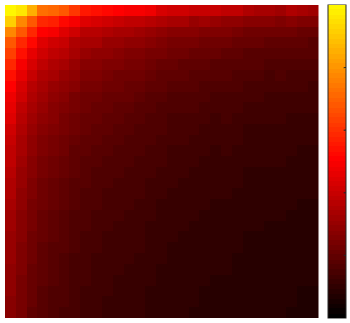
Effect Standard Error
2
0.25
0.20
10
0.15
Participants
Standard Error
30
0.10
20
20
0.05
30
0.0
Trials
10
2

Slide 33
Effect size needed to achieve 95% replication
2
1.0
0.75
10
Participants
Effect Size Required
0.50
30
20
0.25
20
30
0.0
Trials
10
2

Slide 34
Improving the power of experiments
=
Perception
+
Motor Initiation
+
Decision Time

Slide 35
Showing that incorrect trials are actually harder

Slide 36
Showing that incorrect trials are actually harder

Slide 37
Showing that incorrect trials are actually harder
Tuesday Morning
Poster, 53.467

Slide 38
Understanding implicit memory through carryover

Slide 39
Understanding implicit memory through carryover

Slide 40
Outline
Improving scientific practice
Modelling post-hoc research practices
Mechanical Turk pipeline for behavior
Estimating a priori power
Decomposing RT to increase power
Deeply scary things to consider
The ever increasing skill set
Mo’ data, Mo’ problems

Slide 41
With enough data everything is significant
N = 56,081
Error Bars are 99.9999% CI
Accuracy (Hit Rate)

Slide 42
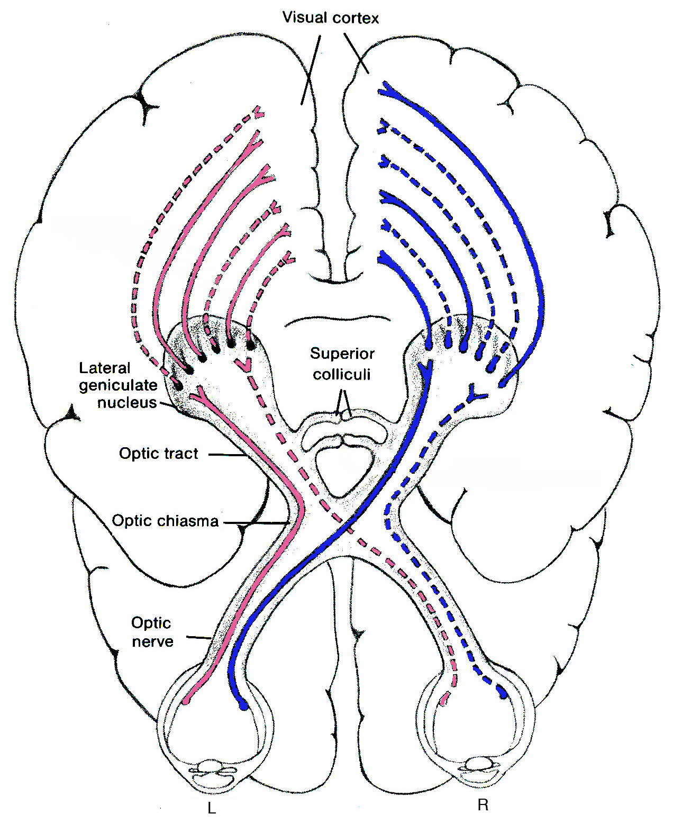
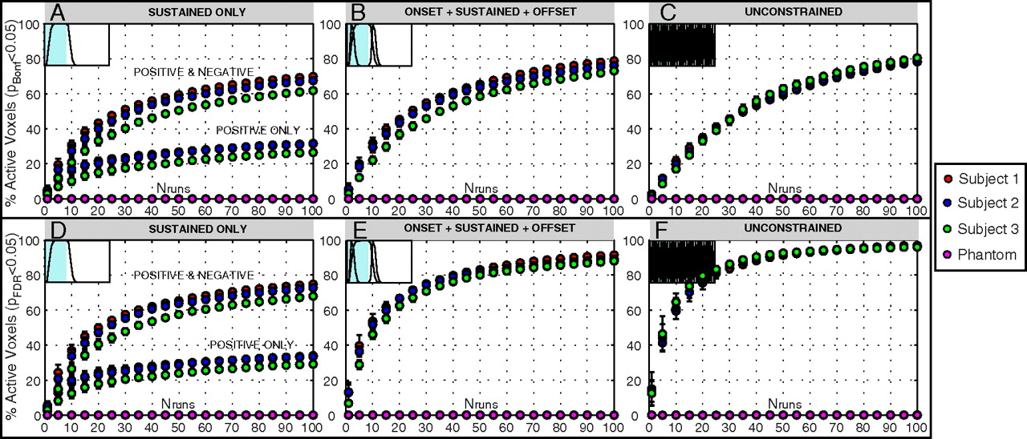
A Thought Experiment
Consider the neural response to two different images. They produce a different pattern of response at the retina and LGN and early visual cortex.
That difference in response likely carries forward to the rest of the cortex, including motor cortex.
Javier Gonzalez-Castillo et al. PNAS 2012;109:5487-5492

Slide 43
A Thought Experiment
Consider the neural response to two different images. They produce a different pattern of response at the retina and LGN and early visual cortex.
That difference in response likely carries forward to the rest of the cortex, including motor cortex.
So, if motor cortex produces a different response to any two different images, then its possible that with enough power we would always observe a difference.
Thus, maybe ALL nulls result from experimenter error and/or low power.
A theory may only be as good as the variance it explains.

Slide 44





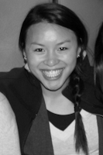



Thanks!
Army Research Office
Department of Homeland Security
Kedlin Co.
Justin
Ericson
Matthew
Cain
Stephen
Adamo
Emma
Wu Dowd
Elise
Darling
Rachel Wynn
Michelle Kramer
Laura Schubel
Adam
Biggs

